Slide 1
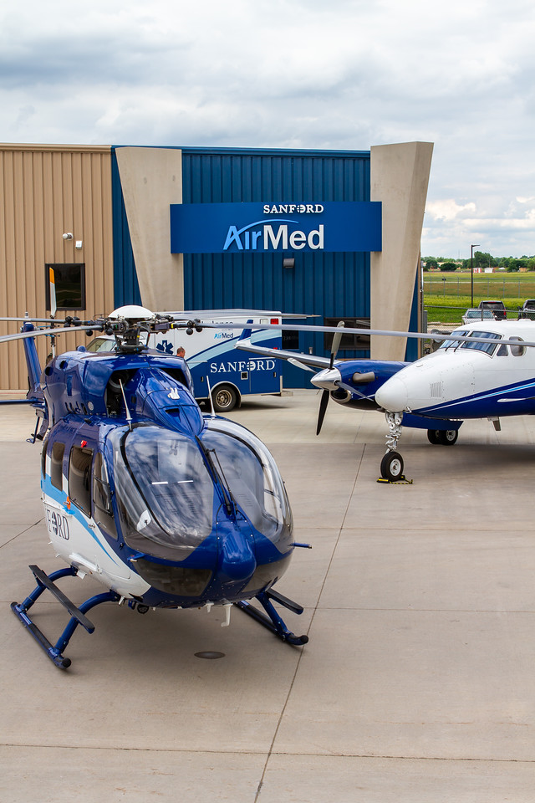
Sanford AirMed 2022

Slide 2
About Us
Sanford AirMed provides air medical transport to critically ill or injured patients throughout our region. Our fleet of critical care helicopters and fixed-wing planes is available 24/7 and fully staffed by experienced emergency medicine specialists. In 2021 Sanford flew over 8000 hrs providing care to those in need. Since our inception in 1977 Sanford has transported over 70,000 patients.

Slide 3
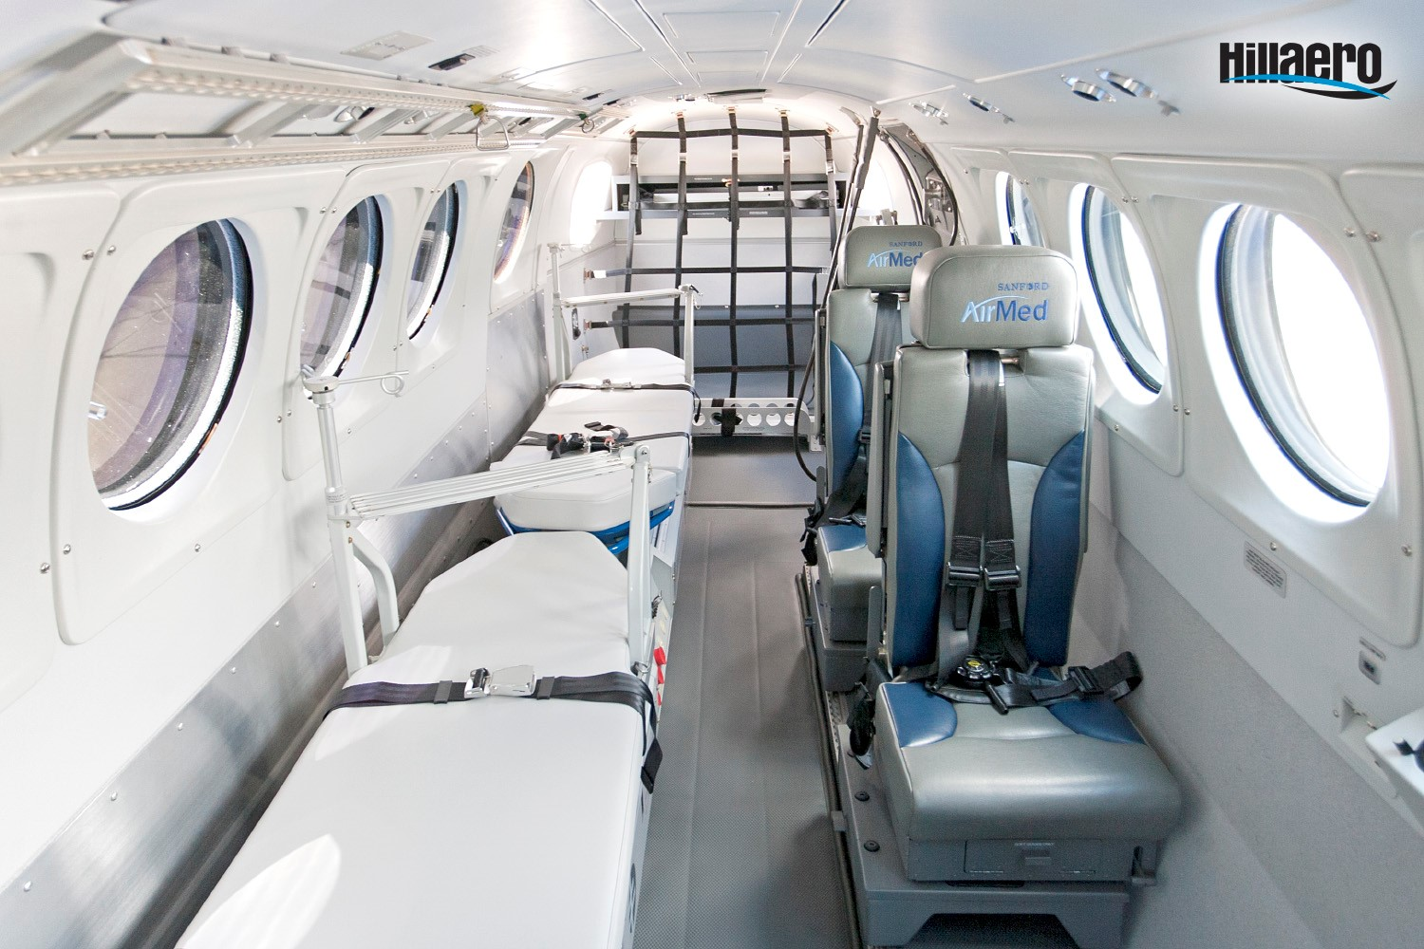
The Teams
Sanford air ambulances provide fast, safe flight services from the scene of accidents and also inter-facility transports to medical centers across the nation. Sanford AirMed has four specialized teams; adult, pediatric, neonatal and OB. During every flight a Flight RN and paramedic are present along with specialized emergency teams to meet the patient’s needs.

Slide 4
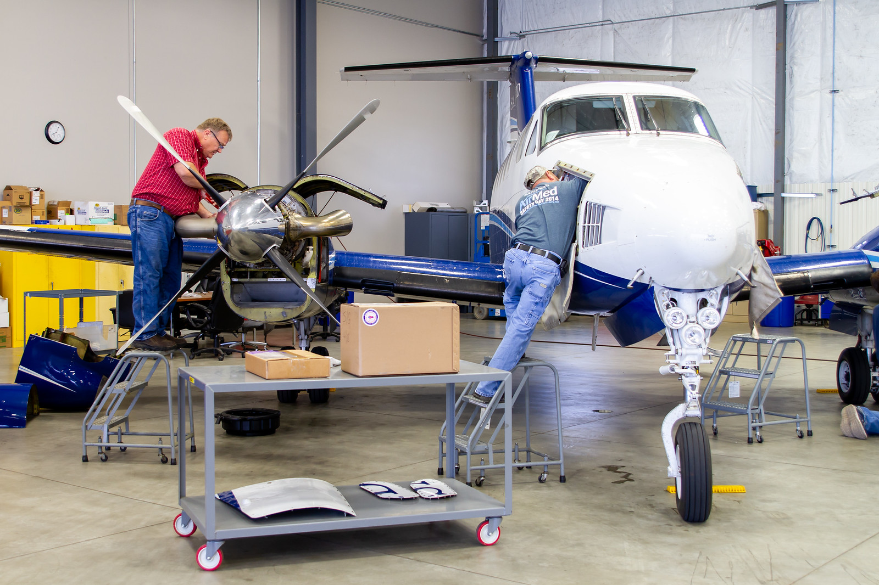
Overview
Sanford AirMed operates under two FAA Part 135 certificates
RW and FW maintenance performed in-house
All pilots attend annual simulator training

Slide 5
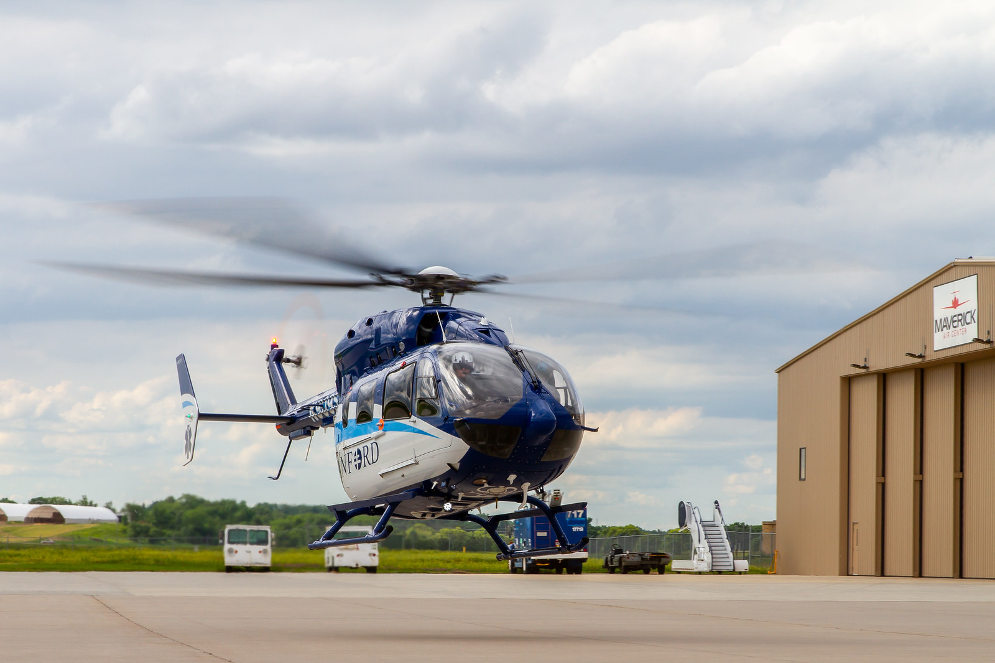
Current State
4 King Air B200 Air Ambulances
3 Business Aircraft
4 Airbus EC 145 Helicopters
30 Fixed Wing Ambulance Pilots
9 Corporate Pilots
17 Rotor Wing Pilots
16 Maintenance Personnel

Slide 6
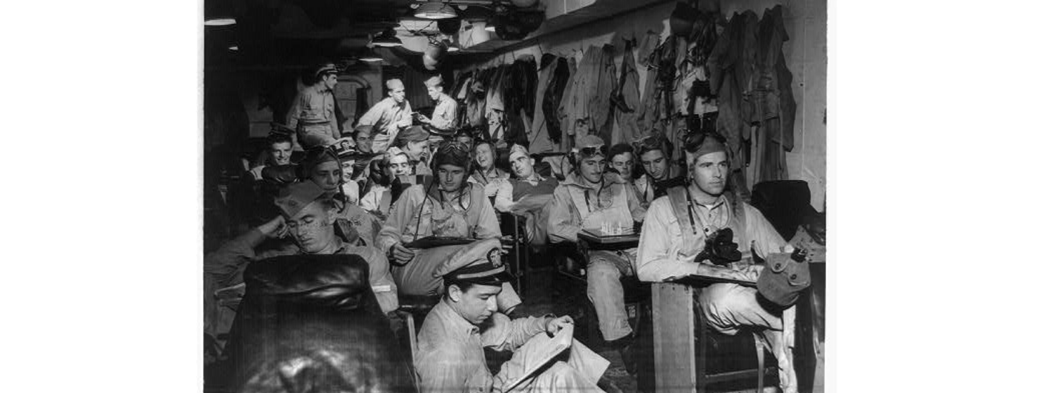
AirMed Locations
Fixed wing pilot bases in Sioux Falls, SD; Fargo, ND; Dickinson, ND.
Rotor wing bases in Sioux Falls, SD; Fargo, ND; Bemidji, MN; and Bismarck, ND.

Slide 7

Leadership
Michael Christianson
System Executive Director, Air Transportation
John Graney
Director of Fixed Wing Operations
Kerry Berg
Director of Rotor Wing Operations
Oakly Haines
Chief Fixed Wing Pilot
Matt Horn
Chief Rotor Wing Pilot

Slide 8
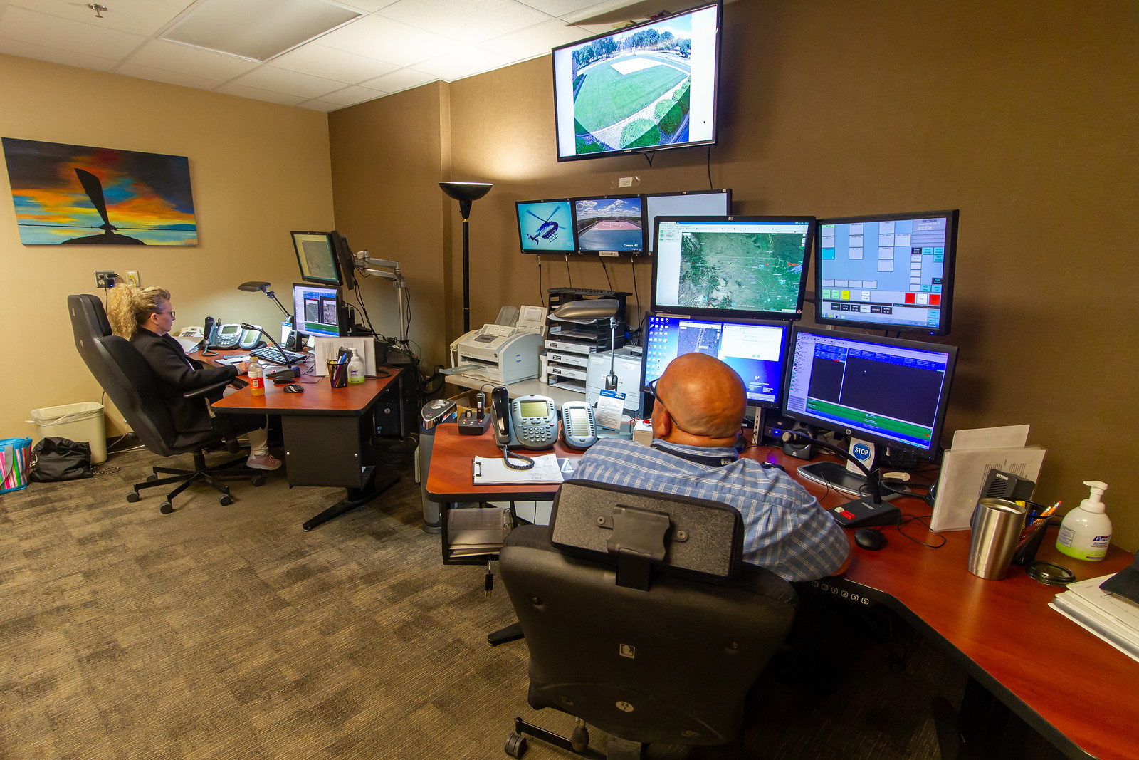
The Call Comes In
When our services are needed, the Sanford communication center, located in Sioux Falls, requests the desired asset, the referring facility, and the necessary medical team….

Slide 9
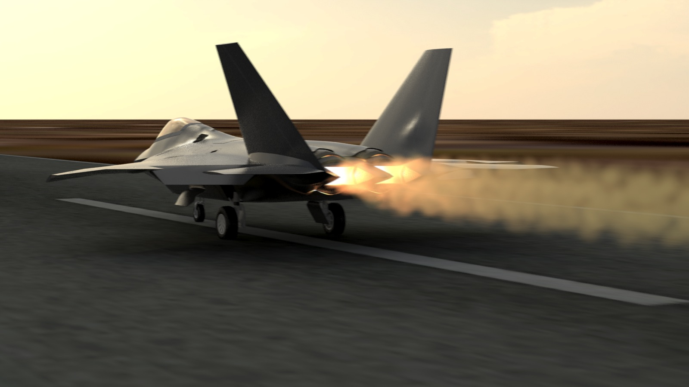
Our goal is to be airborne as fast as possible
In an effort to achieve this goal what we need from our airport managers is:
Updated airport NOTAMS
Accurate runway and taxi conditions
Fuel Availability
Accurate contact information for airport managers. We may call in the middle of the night to request additional services, i.e. hangar, fuel, de-ice.

Slide 10
What's need for Operations?
Minimum runway length 3000ft
Must have runway lights for night operations
Without being in radar coverage we have the inability to depart when weather is below VFR
  The addition of ADS-B ground towers would be a great help to our operation in frequent locations such as Rosebud and Martin
  What is the status of certified weather reporting in SUO?

Slide 11

On behalf of Sanford AirMed THANK YOU for allowing us to be here and to visit with all of you…
QUESTIONS?

